Slide 1

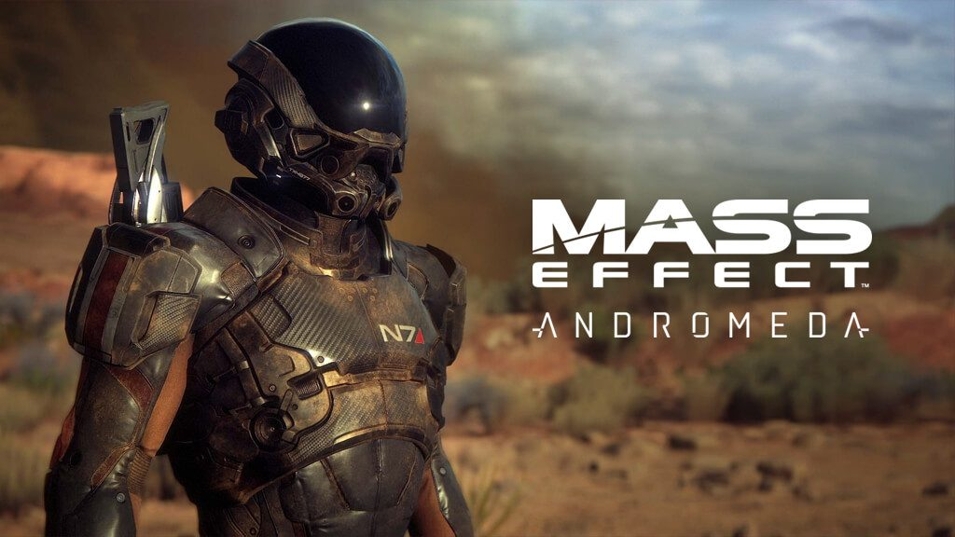

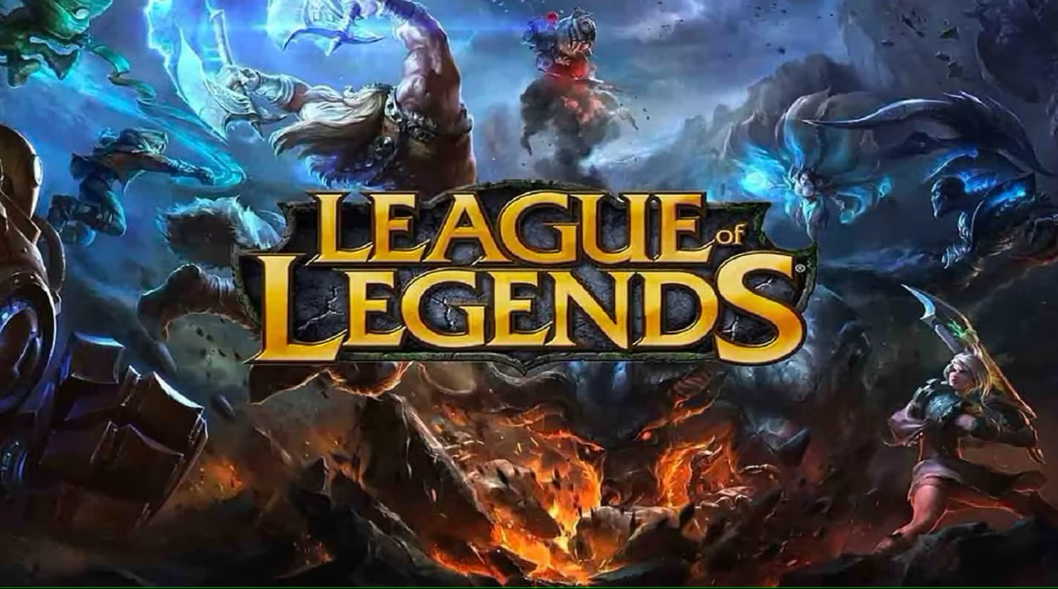
The UX/UI Design
Tenzin Sungrab & Van Bellinghen Brandon

Slide 2
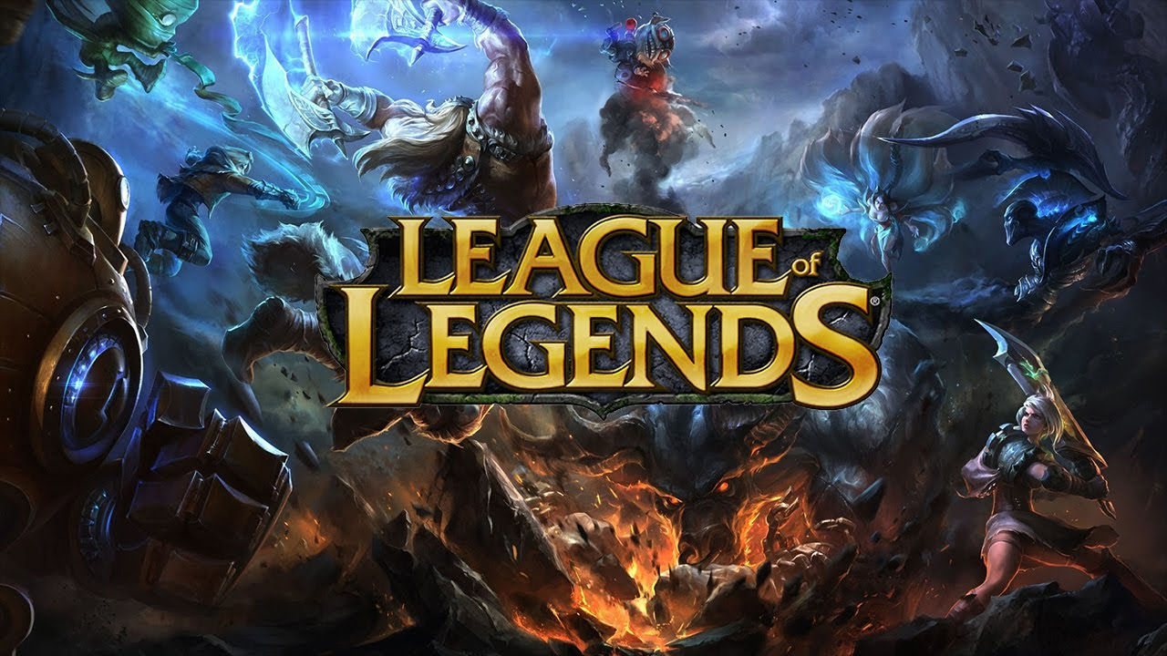
1) One of the best game 2) Moba 5v5

Slide 3
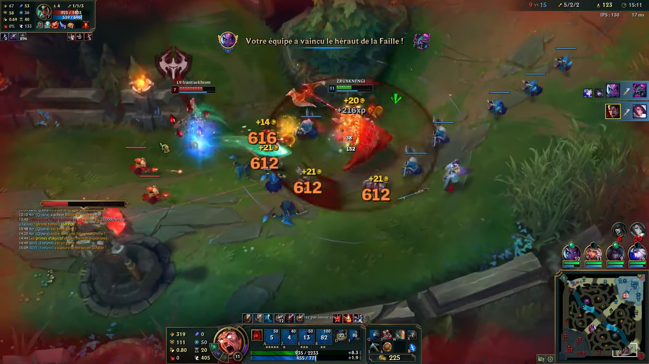
Ui : In game interface

Slide 4
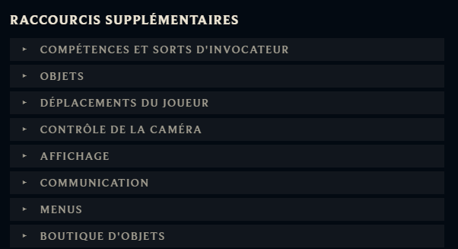
Ui : sitting
You can change the key of all action possible.

Slide 5
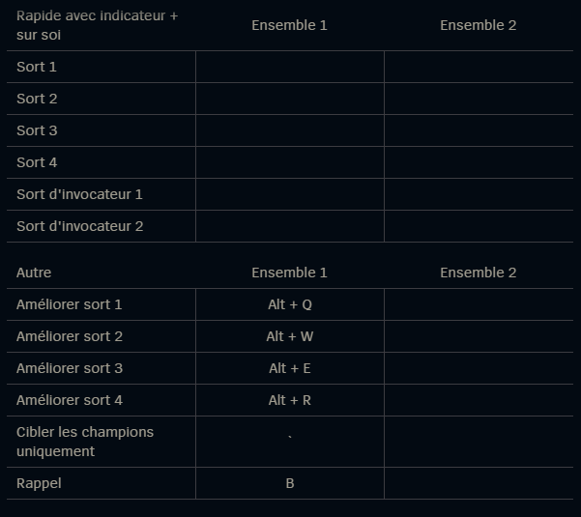
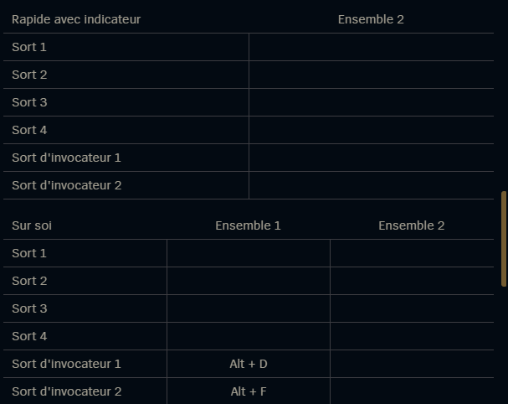
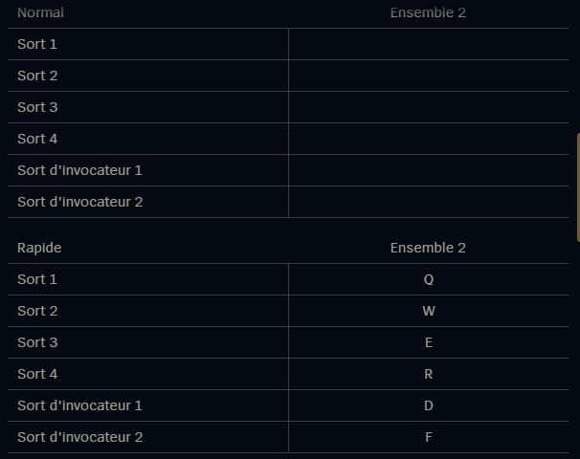
Skill touch

Slide 6
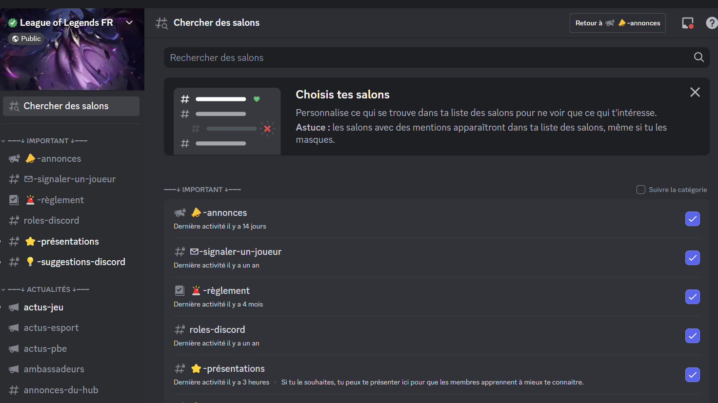
Ux : commutiny

Slide 7
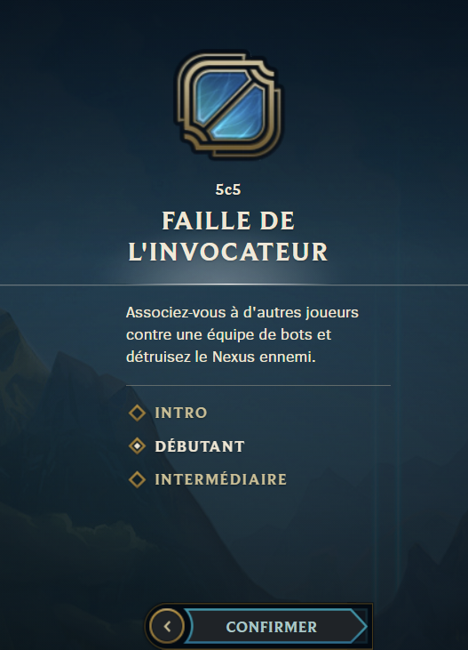

Slide 8

the game that destroyed the reputation
of a famous saga
in the video game world

Slide 9
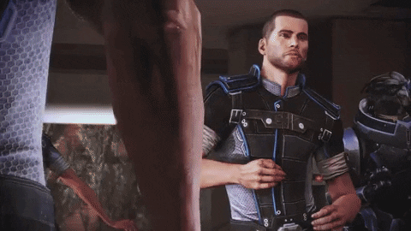

Slide 10
The UI Part

Slide 11
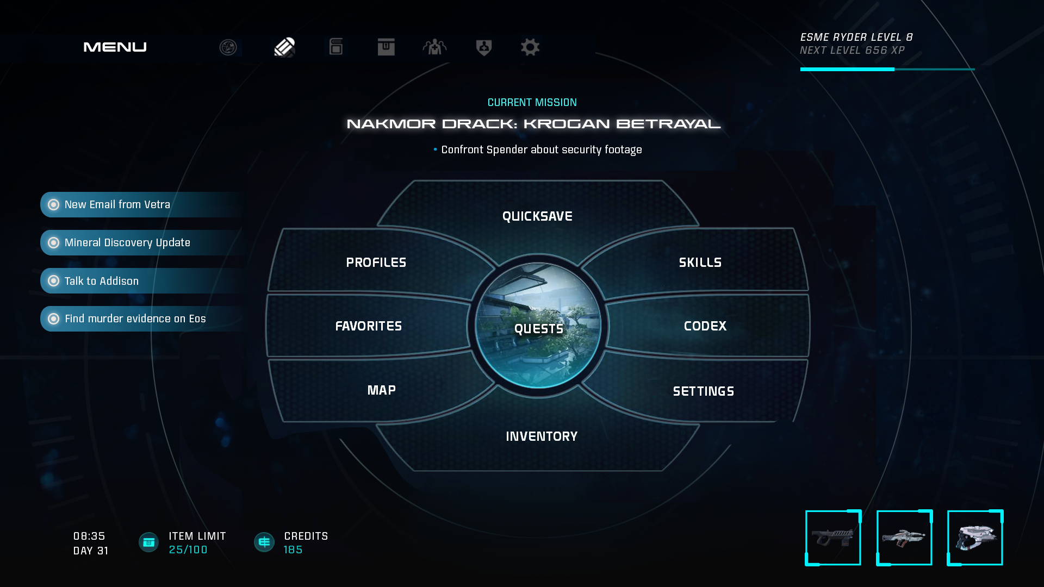
a big problem of the game is the menu

Slide 12
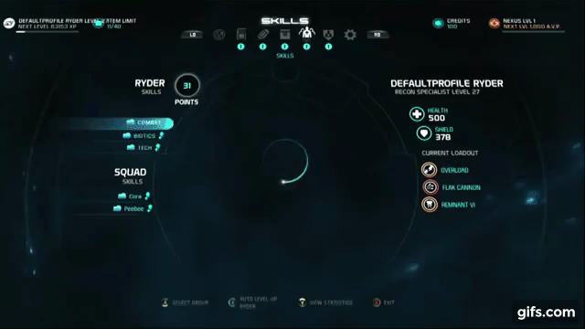

Slide 13
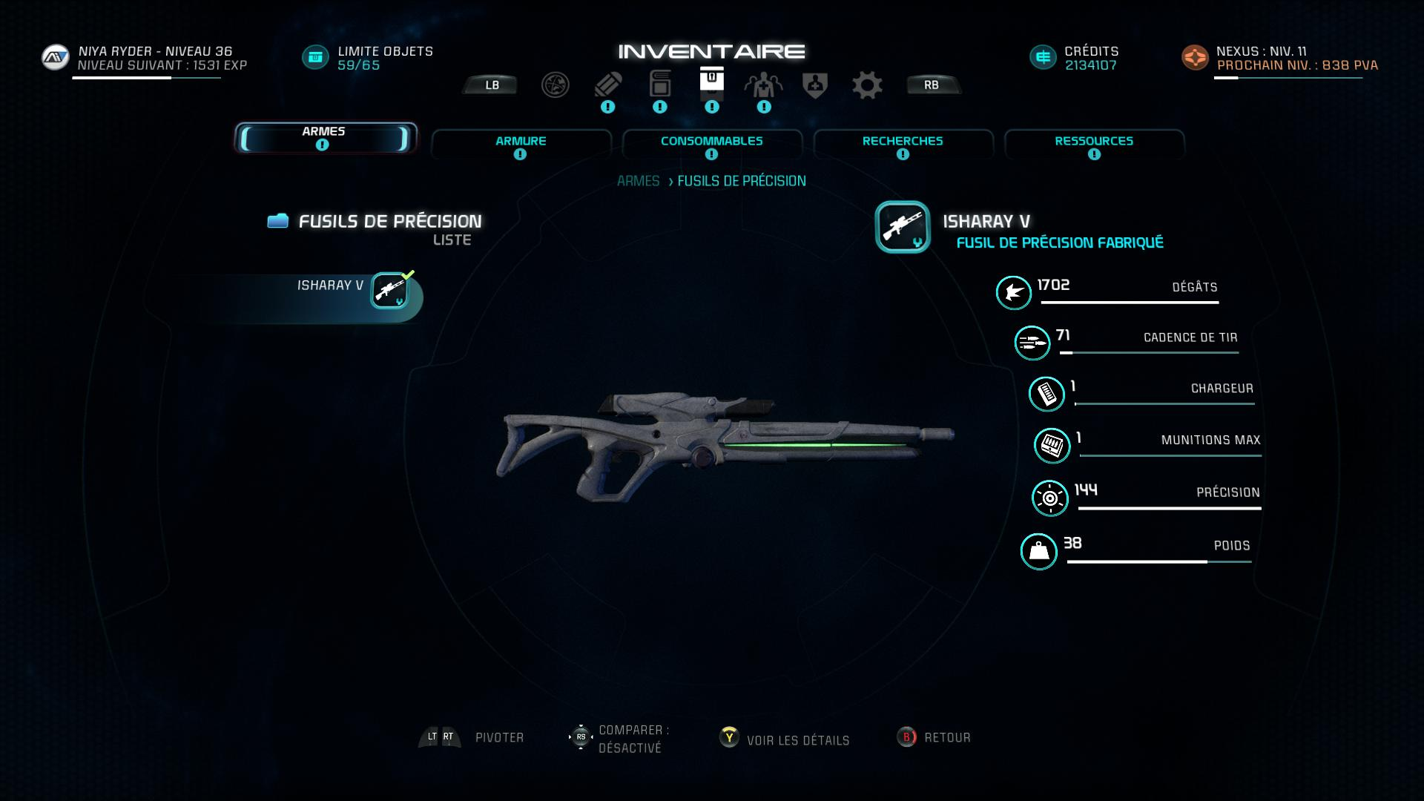
description of weapons and other

Slide 14
The UX Part

Slide 15
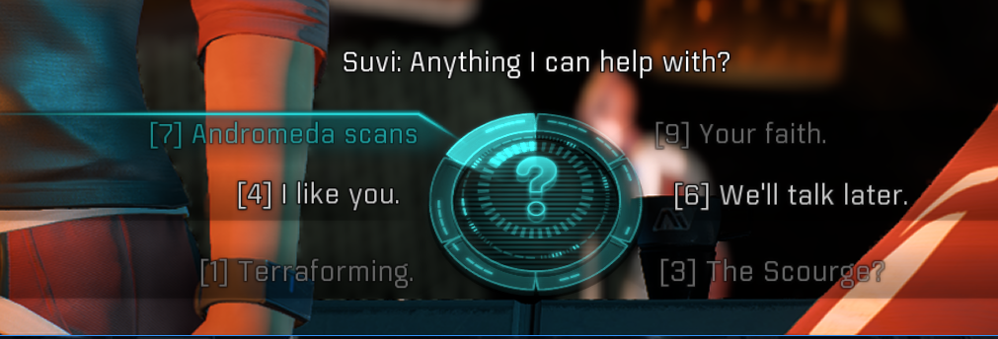
one of the problems is the game's dialogue

Slide 16
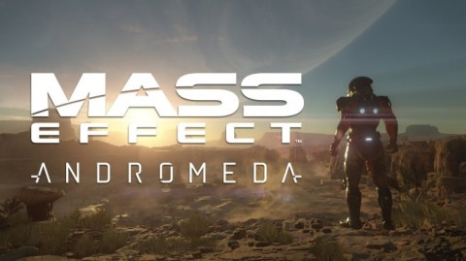
the UX that destroys game history

Slide 17
common negative points

Slide 18
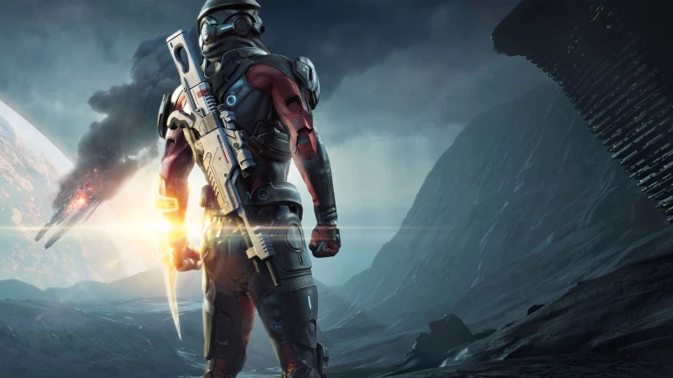
bugs and glitches are common
problems between UX and UI

Slide 19
some bugs and glitches in the game

Slide 20
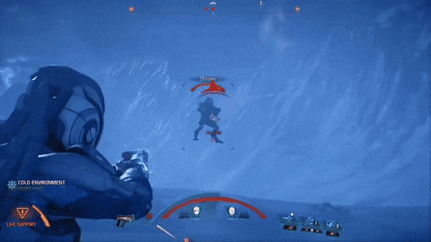

Slide 21
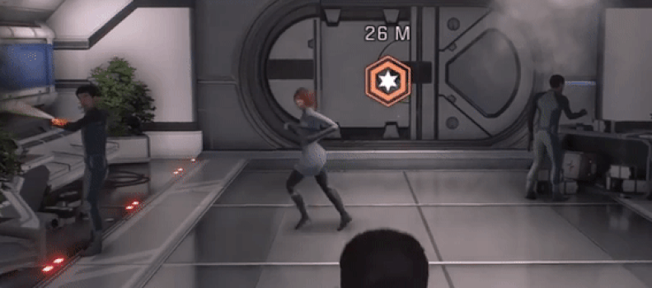

Slide 22
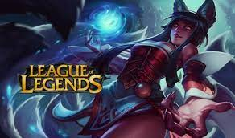
QUESTION

